Slide 1
Single Image Super Resolution
Enhancing Image Quality for Diverse Application
Team Members
Amit Nareshkumar Bhasita(16.6%)
Arnika Kaithwas(16.6%)
Heet Mayurbhai Dave(16.6%)
Shubhashish Shukla(16.6%)
Suvam Mukhopadhay(16.6%)
Yashil Jogi(16.6%)

Slide 2
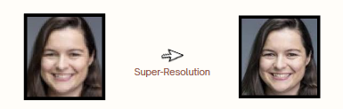
Introduction
Single-Image Super-Resolution (SISR) enhances low-resolution images for critical applications like medical imaging and surveillance, but existing methods often struggle to preserve fine details, handle diverse image types, and maintain efficiency in real-world scenarios.

Slide 3
Problem Statement
Current super-resolution models struggle with preserving fine details, generalizing across diverse image types, and handling real-world degradations. Many depend on bicubic downsampling, which poorly reflects real-world conditions, while Transformer-based models, though accurate, are computationally intensive. Many rely on bicubic downsampling, which fails to replicate real-world degradations, leading to suboptimal performance. Additionally, Transformer-based models, though powerful, are computationally expensive, limiting their practicality.

Slide 4
Aim of the Project
Develop a robust super-resolution system for generating sharp, realistic, and high-fidelity images from low-resolution inputs.
Real World Applications
Surveillance & Security
Media Restoration
E-commerce & Mobile Apps
Automotive (ADAS)
Medical Imaging
Satellite & Aerial Imaging

Slide 5
Model 1: RRDB + Transformer (dual attention)
Objective:
4× Image Super-Resolution on DIV2K Dataset Architecture:
Backbone: Residual-in-Residual Dense Blocks (RRDBs)
- Captures multi-level contextual features
Dual Attention Block:
- Channel Attention: Focus on relevant feature maps
- Spatial Attention: Focus on important spatial regions
Training Setup: - Loss: 0.7 × L1 + 0.25 × VGG Perceptual + 0.05 × TV - Patch Size: 384×384 HR / 96×96 LR - Optimizer: Adam | Epochs: 40 | Batch Size: 4
Evaluation: - Metrics: PSNR, SSIM Highlights: - Sharp textures, robust to blur/noise - Attention enhances feature selectivity - Smooth results with low artifacts

Slide 6
Model 2: Depth-wise conv+ dual attention
Dataset & Degradation:-
DIV2K for training/validation & Set14 for test
HR images LR images created via bicubic downsampling (4× degradation).
Model Architecture:-
CNN Backbone: -
Lightweight residual blocks using Depth-wise Separable Convolutions.
Residual Block: Conv → ReLU → Depthwise Conv → Conv + skip connection
Transformer Block:-
Multi-head attention over reduced feature maps + Feedforward
LayerNorm applied before attention & feedforward layers for stability
Dual Attention: -
Channel Attention: Focus on important channels in feature maps.
Spatial Attention: Localize and focus on important regions.
Conv Upsampling: 2 Conv layers → PixelShuffle for 4× upscale
Loss Functions:-
L1 Loss: Pixel-level difference
Perceptual Loss: Feature-level similarity using VGG19
TV Loss: Encourages spatial smoothness
L_total = 1x L1 + 0.01 × Perceptual + 0.0001 × TV
Training and Evaluation:-
Optimizer: Adam (lr = 1e-4)
Epochs: 30
Batch Size: 4
Metrics:- PSNR and SSIM
PSNR=19.21 and SSIM=0.4677 on DIV2K validation dataset.
PSNR-17.34 and SSIM=0.4568 on Set14 dataset.
Total params: 149,655
Trainable params: 149,655
Non-trainable params: 0

Slide 7
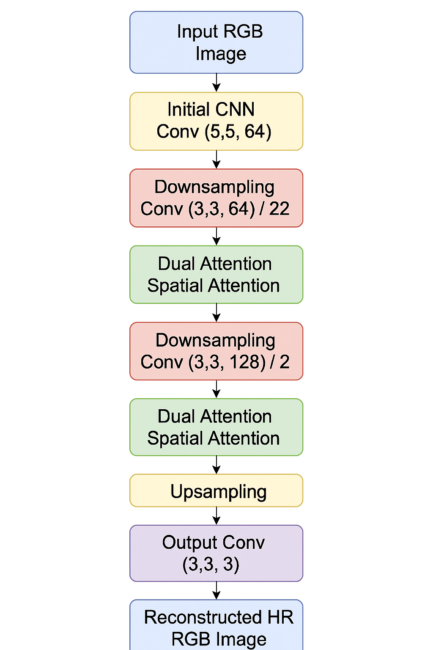
Model 3: Enhanced Dual-Attention CNN
Uses 2D Convolution along with relu activation function to capture low level features such as edges, textures.
Uses Conv2D layers with stride of 2 to reduce the spatial dimension.
Dual Attention Block – Uses Channel attention to capture what is important across different channels.
And Spatial attention focuses on where the important information lies.
Uses Upscaling2D to recover spatial resolution
A final Conv2D layer with 3 output channels (RGB) and sigmoid activation.
Uses MSE as a loss function to find pixel wise loss between High Resolution and Low Resolution image.
Average PSNR – 20.3 and SSIM – 0.49, Parameters 144k

Slide 8
Layer Normalization
For image super-resolution, precise pixel intensities matter and Batch Normalization may blur or distort fine image details also may add artifacts and degrade PSNR, SSIM values.
So we are using Layer Normalization which normalizes across the features of each individual sample, not across the batch.
LayerNorm treats each pixel independently — it doesn’t mix statistics across the image. It would be helpful because per pixel accuracy is maintained.
LayerNorm is batch-size independent that is essential for super-resolution tasks where memory is limited.
So we are adding LayerNorm in the Transformer Block for better stability and convergence.

Slide 9
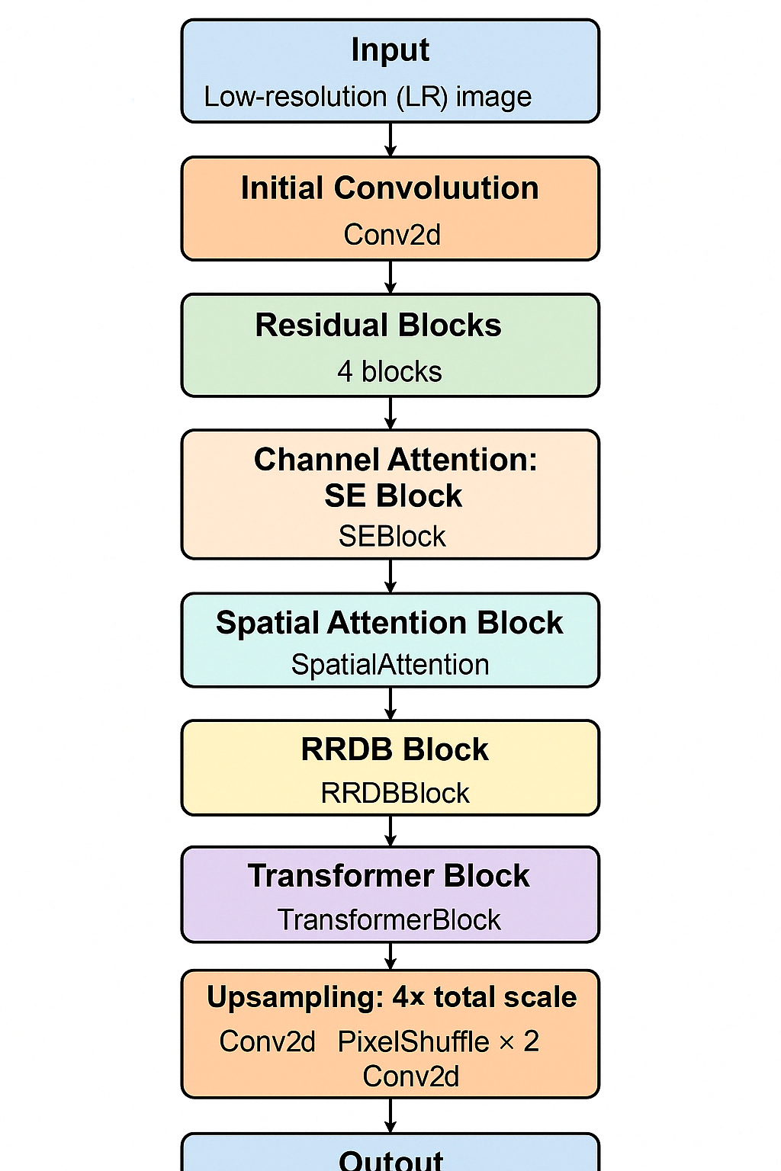
Our Final Model Architecture

Slide 10
Overview of the SRModel Block
Clean up the noise (residual blocks)
Focus on the important features (attention)
Deepen understanding of textures (RRDB)
Reason globally across the whole image (transformer)
Finally upscale & reconstruct the image (pixel shuffle)
2. local detail recovery with global context awareness
The sequence is based on progressive refinement: learn → focus → deepen → reason → reconstruct
3. Attention before RRDB: Helps RRDB focus on the right features early
4. Transformer at the end: Global reasoning is most effective after local fixes are done
5. No BatchNorm used: As shown in SOTA papers (EDSR, RCAN), BatchNorm can blur fine edges

Slide 11
Sequence Stage | Block Used | Justification
1. Feature Extraction | Conv2d + Residual ×4 | Basic edge, texture, and local pattern learning — prepares foundational low-level features
2. Channel Attention | SEBlock | Learns which feature channels (e.g., textures, colors, contours) are important — improves representation without spatial overhead
3. Spatial Attention | SpatialAttention | Refines the focus to important regions in the image (e.g., eyes, edges, object boundaries)
4. Deep Feature Enhancement | RRDBBlock | Captures complex feature interactions via residual-dense pathways — brings robustness from ESRGAN-style depth
5. Global Reasoning | TransformerBlock | Models long-range dependencies (e.g., context between far parts of the image) — boosts coherence and high-frequency detail recovery
6. Upsampling | PixelShuffle + Conv | Converts rich feature map into final super-resolved image using 4× scaling

Slide 12
Loss Function | What it Does | Analogy / Simple Explanation
Pixel-wise Loss (L1) | Makes output pixels close to HR ground truth | Like comparing each pixel value directly
VGG Perceptual Loss | Makes output look perceptually similar to HR | Compares high-level visual features, not pixels
TV Loss | Reduces noise and enforces smoothness | Encourages natural textures without artifacts
LAB Color Loss | Boosts accurate and vibrant color reconstruction | Makes color shades match ground truth better
Laplacian Loss | Sharpens edges and enhances texture clarity | Highlights edges (like pencil sketch filters)

Slide 13
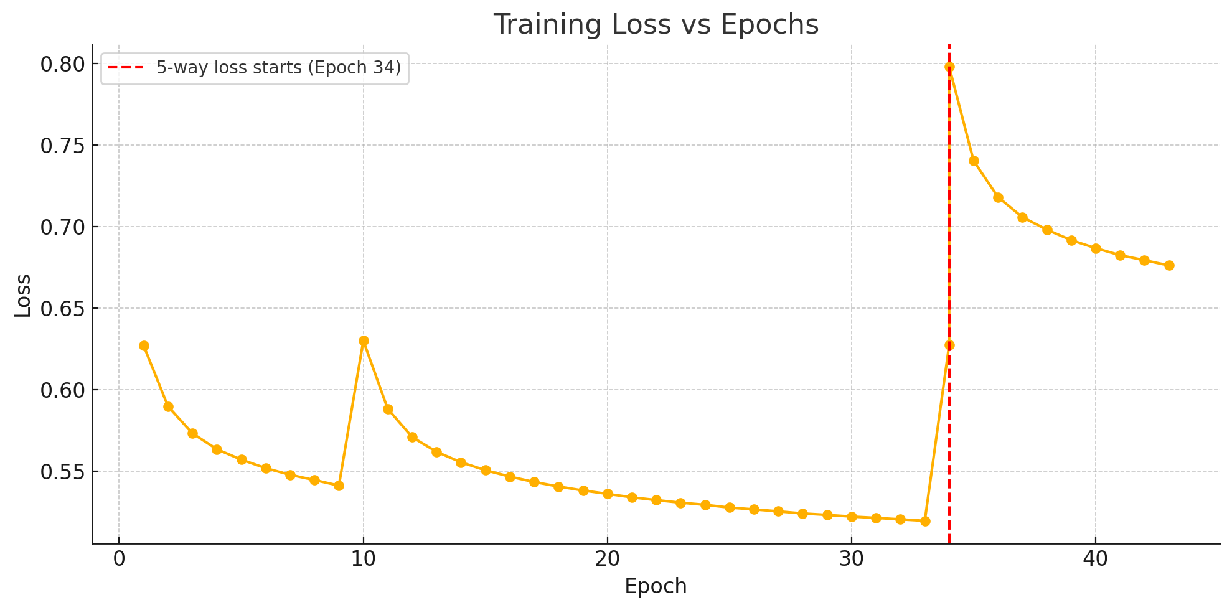
Model Training Analysis

Slide 14
Model Training Information
This small bump between Epoch 9 and 10 is due to patch randomness — since we train on randomly extracted patches from HR images, some epochs contain more complex content (e.g. faces, textures, edges), causing the model to briefly struggle. The drop resumes right after, confirming it was a local variation and not a model failure.
Initial training phase with 3 loss functions: L1 pixel-wise, VGG perceptual, and total variation loss. The model learns structure and smoothness.
We introduced color and sharpness-focused objectives — LAB Color Loss and Laplacian Sharpness Loss. The loss increases slightly due to the added complexity, but the SR quality visibly improves.
Old loss = ( 0.2 * l1_loss(sr, hr) + 0.5 * vgg_loss(sr, hr) +0.1 * tv_loss(sr)
New loss = ( 1.0 * l1_loss(sr, hr) + 0.5 * vgg_loss(sr, hr) + 0.1 * tv_loss(sr) + 0.2 * lab_color_loss(sr[0], hr[0]) + 0.05 * laplacian_loss(sr, hr) )

Slide 15
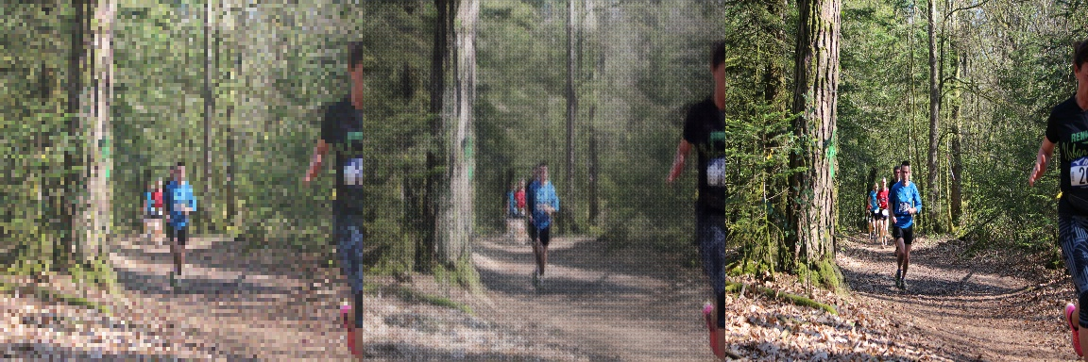
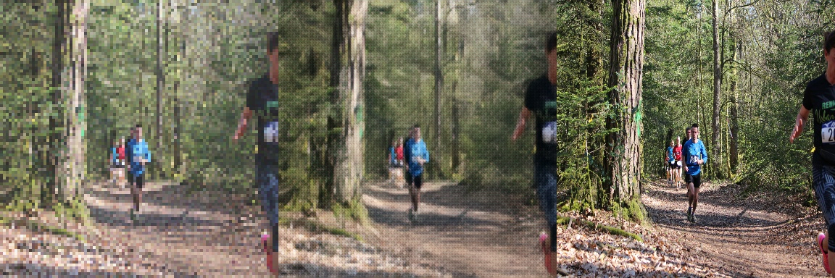

Slide 16
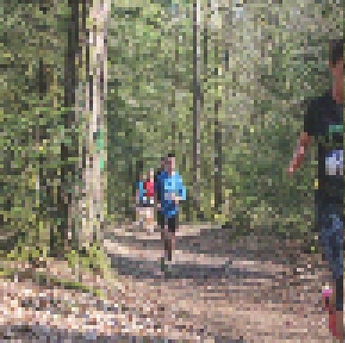
Model Training Information Cont.
We use a custom degrade_image() function with:
Gaussian Blur → simulates optical softness
Downscaling → introduces pixelation (boxy artifacts)
Noise + Haze → mimics sensor distortion
This makes the LR image visually degraded — challenging but learnable.

Slide 17
Model Training Information Cont.
Training on LR-HR Patch Pairs
LR : 96×96
HR : 384×384
The model learns to upscale degraded LR patches to HR-quality outputs. This ensures that even small patches can be restored sharply.
Inference Using Patch Stitching
At test time, we don’t resize the whole LR image to 96×96 Instead:
Extract 96×96 patches from full LR
Apply SR model on each patch → get 384×384 SR patch
Stitch all SR patches together
This preserves fine details across the entire image and avoids detail loss from resizing.

Slide 18
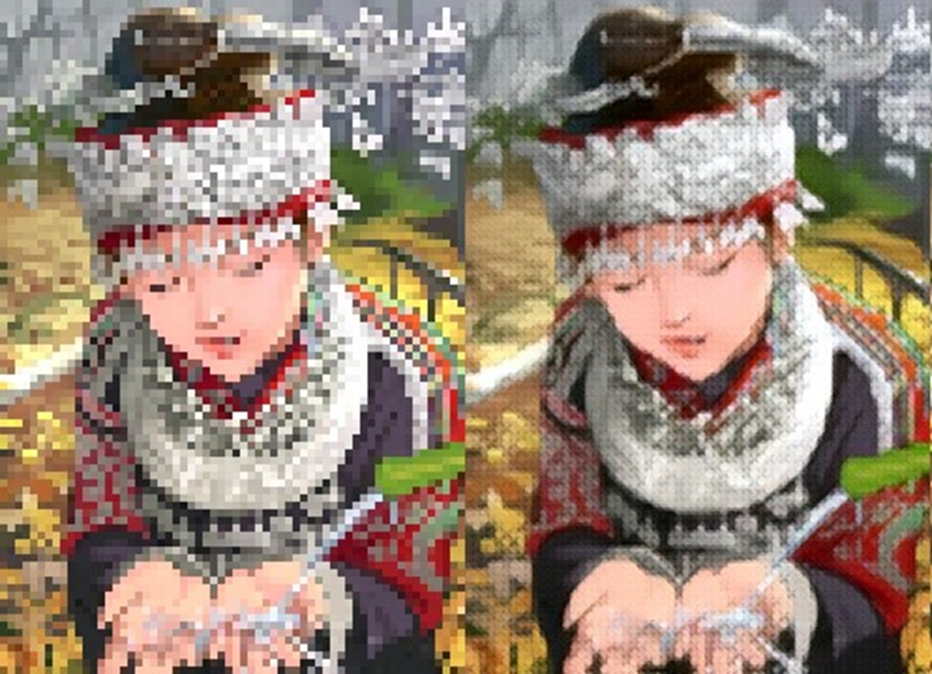
Input Vs Output

Slide 19
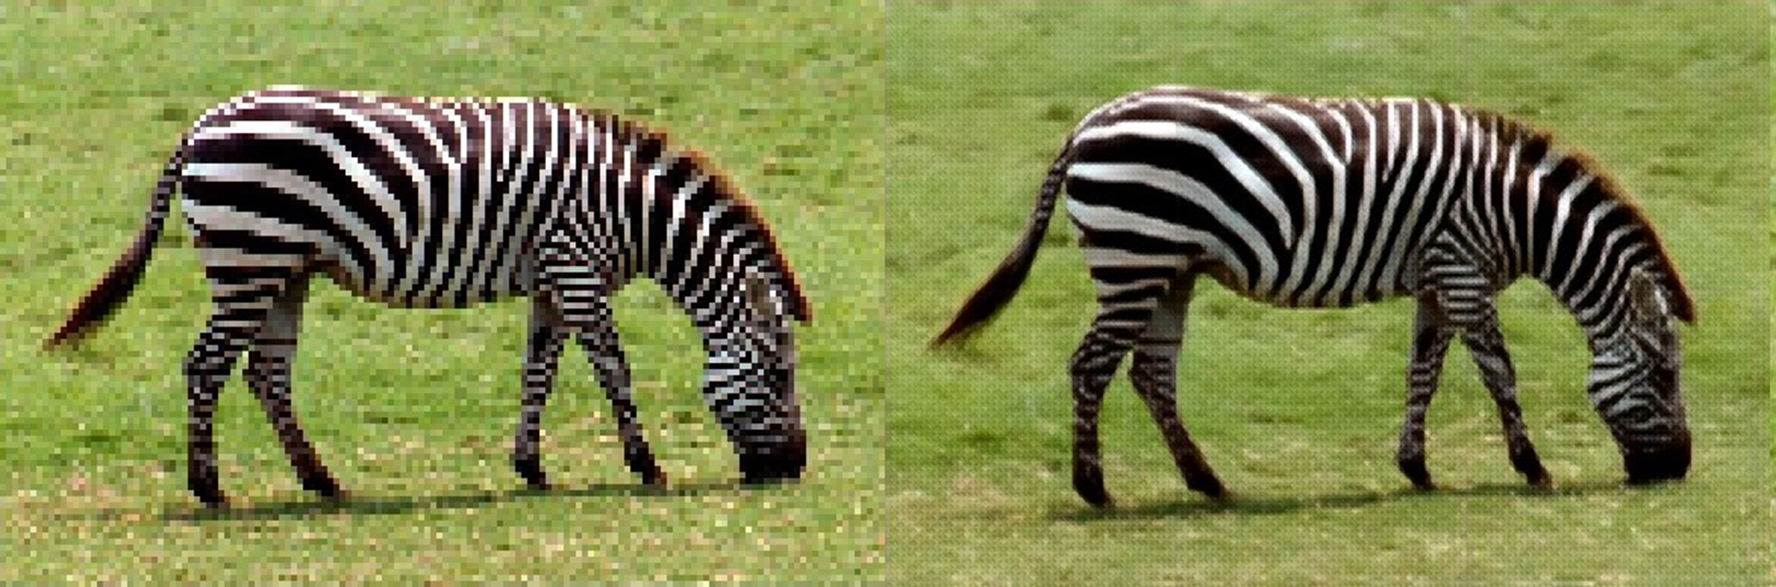
Input Vs Output

Slide 20

Input Vs Output

Slide 21
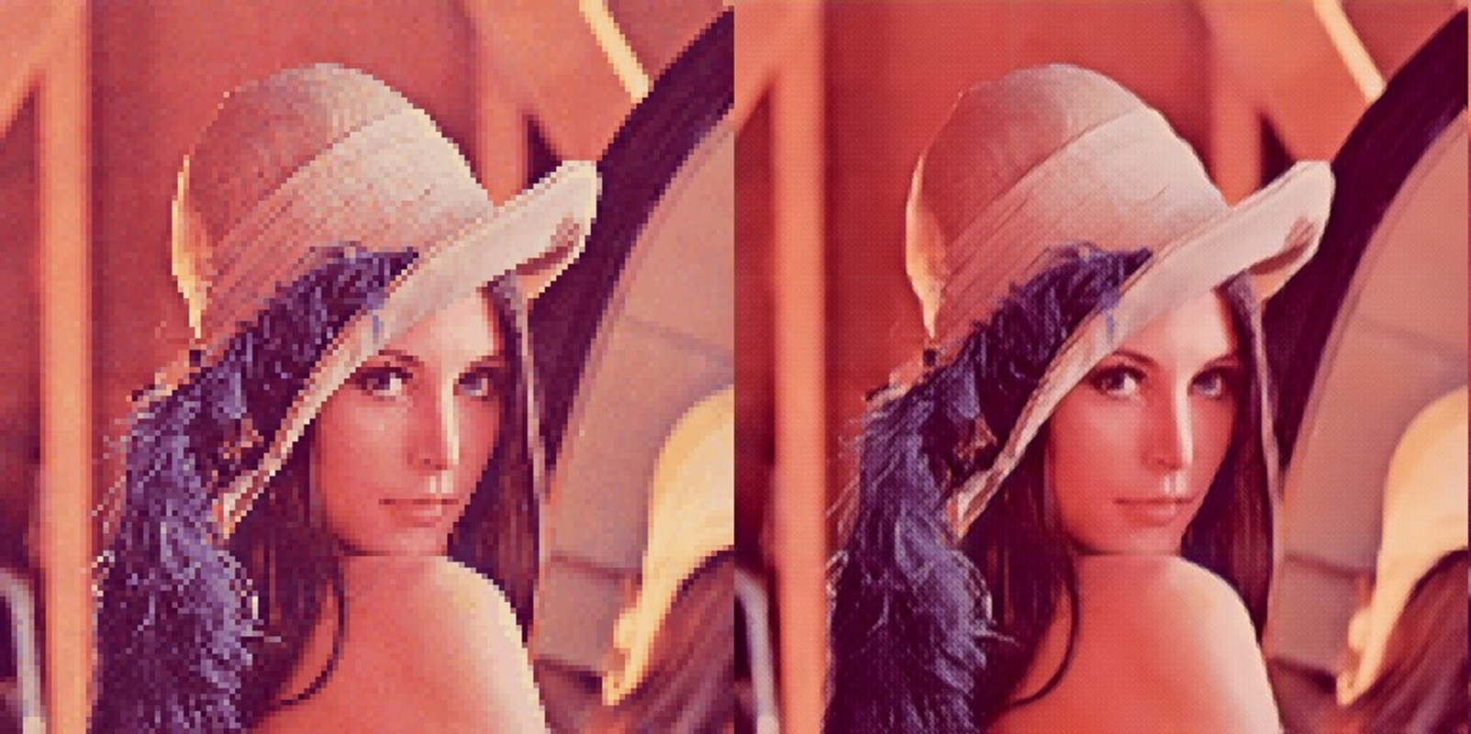
Input Vs Output

Slide 22
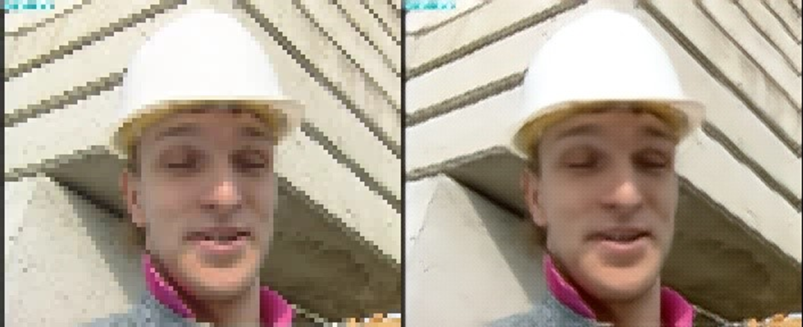
Input Vs Output

Slide 23
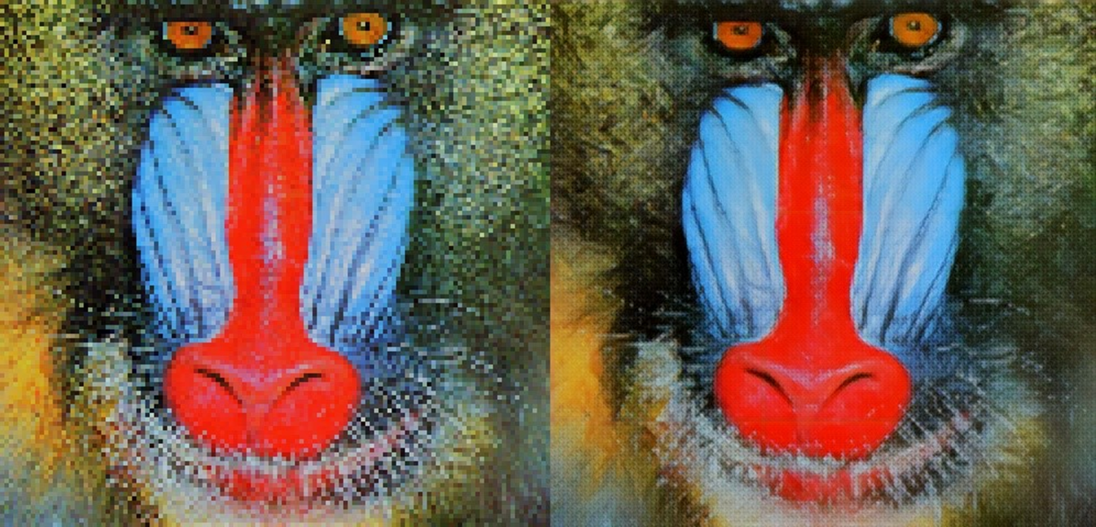
Input Vs Output

Slide 24

Input Vs Output

Slide 25
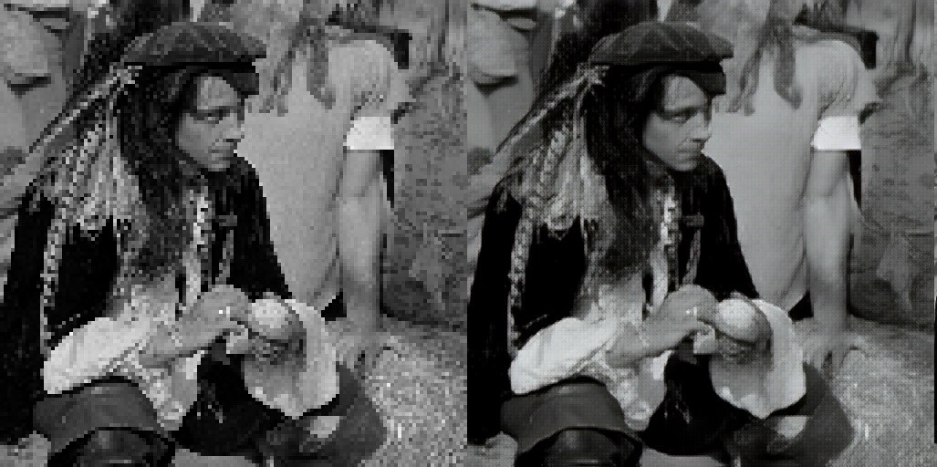
Input Vs Output

Slide 26

Input Vs Output

Slide 27

Input Vs Output

Slide 28

Input Vs Output

Slide 29
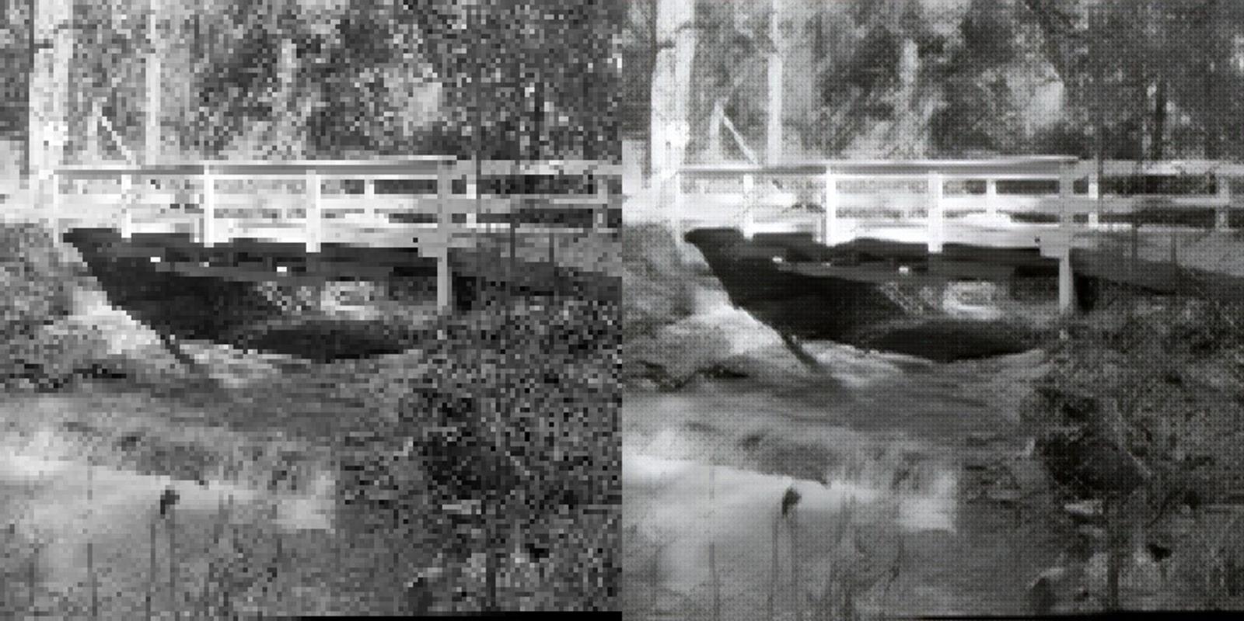
Input Vs Output

Slide 30
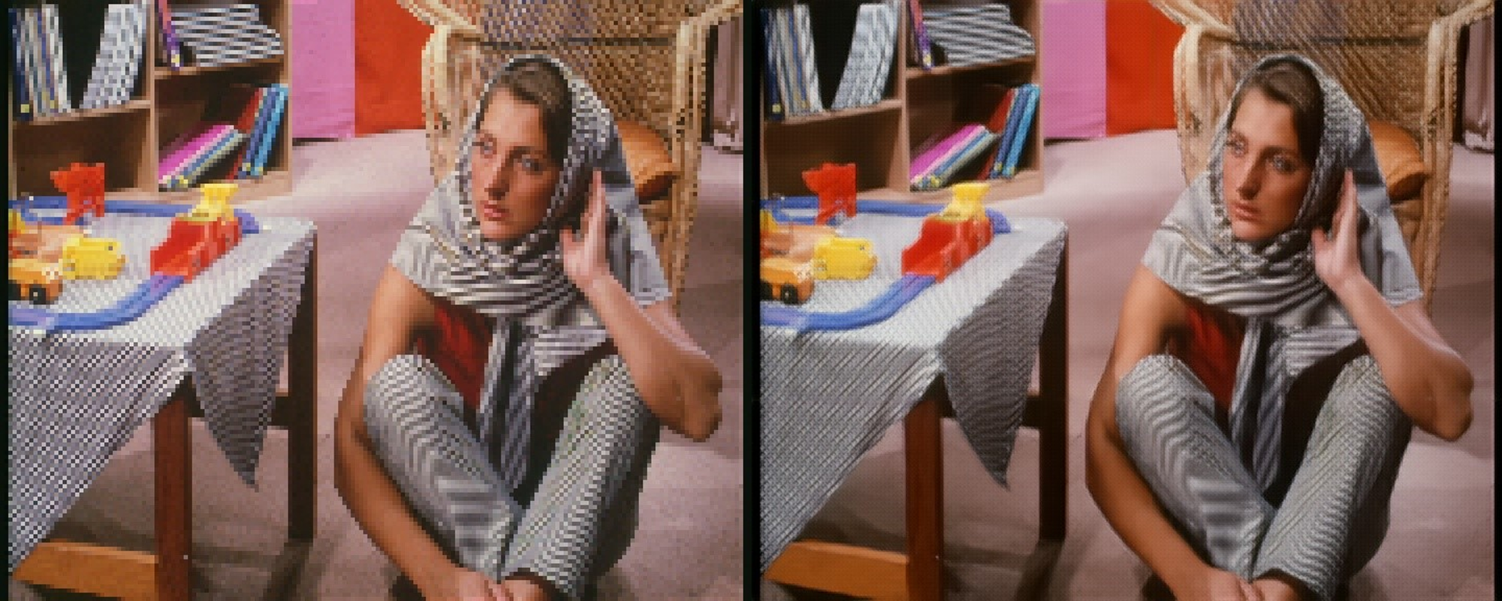
Input Vs Output

Slide 31
Model Comparison
Model Name | Parameters | Set14 PSNR | Set14 SSIM
Our Model | ~1.5M | 22.5 dB | 0.65
ESRGAN | ~16.7M | 28.94 dB | 0.790
SwinIR | ~11.9M | 29.09 dB | 0.789
ProSR | ~38M | 28.94 dB | 0.790
Model Name | % inc in Params | % inc in PSNR | % inc in SSIM
Our Model | _ | _ | _
ESRGAN | 1013.33 | 28.6 | 21.5
SwinIR | 693.33 | 29.2 | 21.3
ProSR | 2433.33 | 28.6 | 21.5

Slide 32


Slide 33
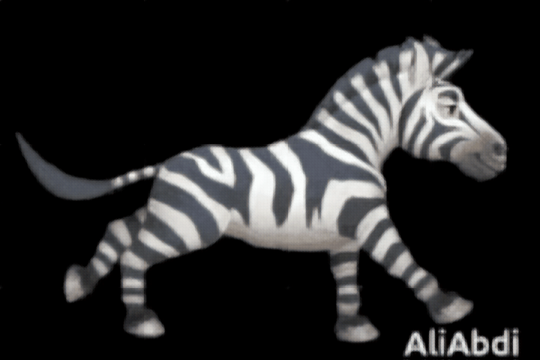

Slide 34
Thank You!

